Slide 1

Unit Testing
Error and Exception Handling, Unit Testing, Test Cases, Assertions
SoftUni Team
Technical Trainers
Software University
http://softuni.bg

Slide 2
Table of Contents
Error Handling
Exception Handling
Unit Testing - Concepts
Mocha and Chai for Unit Testing

Slide 3
Have a Question?
sli.do #JS-CORE

Slide 4

Error Handling
Concepts, Examples, Exceptions

Slide 5
Types of Errors
There are three types of errors in programming:
Syntax Errors - occur at compile time.
Runtime Errors - occur during execution (after compilation).
Logical Errors - occur when you make a mistake in the logic that drives your script and you do not get the result you expected.

Slide 6
Error Handling - Concepts
A function failed to do what its name suggests should:
Return a special value (e.g. undefined / false / -1).
Throw an exception / error.
let str = "Hello, SoftUni";
console.log(str.indexOf("Sofia")); // -1
// Special case returns a special value to indicate "not found".

Slide 7

Error Handling
The fundamental principle of error handling says that a function (method) should either:
Do what its name suggest
Indicate a problem
Any other behavior is incorrect

Slide 8
Error Handling - Exceptions (Errors)
Exception - a function is unable to do its work (fatal error).
let arr = new Array(-1); // Uncaught RangeError
let bigArr = new Array(9999999999); // RangeError
let index = undefined.indexOf("hi"); // TypeError
console.log(asfd); // Uncaught ReferenceError
console.print('hi'); // Uncaught TypeError

Slide 9
Error Handling - Special Values
let sqrt = Math.sqrt(-1); // NaN (special value)
let sub = "hello".substring(2, 1000); // llo
let sub = "hello".substring(-100, 100); // hello
// Soft error - substring still does its job: takes all
available chars
let inv = new Date("Christmas"); // Invalid Date
let dt = inv.getDate(); // NaN

Slide 10
Unexpected (Not Obvious) Behavior
In JavaScript, the first month (January) is month number 0, so December returns month number 11.
let date = new Date(2016, 1, 20); // Feb 20 2016
let date1 = new Date(1, 1, 1); // Feb 01 1901
let dateMinus1 = new Date(-1, -1, -1); // Nov 29 -2
let dateNext = new Date(2016, 1, 30) // Mar 01 2016 (next month)
let datePrev = new Date(2016, -1, 30); // Dec 30 2015 (prev month)

Slide 11

Exception Handling
Throwing / Catching Errors

Slide 12
Throwing Errors (Exceptions)
The throw statement lets you create custom errors
General Error
throw new Error("Invalid state")
Range Error
throw new RangeError("Invalid index")
Type Error
throw new TypeError("String expected")
Reference Error
throw new ReferenceError("Missing age")

Slide 13
Try - catch
The try statement lets you test a block of code for errors.
The catch statement lets you handle the error.
Try and catch come in pairs:
try { // Code that can throw an exception // Some other code → not executed in case of error! } catch (ex) { // This code is executed in case of exception // Ex holds the info about the exception }

Slide 14
Exception Properties
An Error object with properties will be created.
try {
throw new RangeError("Invalid range.");
console.log("This will not be executed.");
} catch (ex) {
console.log("Exception object: " + ex);
console.log("Type: " + ex.name);
console.log("Message: " + ex.message);
console.log("Stack: " + ex.stack); }

Slide 15

Unit Testing
Definition, Structure, Examples, Frameworks

Slide 16
Unit Testing
A unit test is a piece of code that checks whether a piece of functionality is working as expected.
Allow developers to see where (and why) errors occur.
function sortNums(arr) { arr.sort((a,b) => a - b); }
let nums = [2, 15, -2, 4]; sortNums(nums);
if (JSON.stringify(nums) === "[-2,2,4,15]") { console.error("They are equal!"); }

Slide 17
Unit Tests Structure
The AAA Pattern: Arrange, Act, Assert
// Arrange all necessary preconditions and inputs
let nums = [2, 15, -2, 4];
// Act on the object or method under test
sortNums(nums);
// Assert that the obtained results are what we expect
if (JSON.stringify(nums) === "[-2,2,4,15]"){
console.error("They are equal!");
}

Slide 18

Unit Testing Frameworks
JS Unit Testing:
Mocha, QUnit, Unit.js, Jasmine
Assertion frameworks (perform checks):
Chai, Assert.js, Should.js
Mocking frameworks (mocks and stubs):
Sinon, JMock, Mockito, Moq

Slide 19

Mocha and Chai
Unit Testing with Mocha and Chai

Slide 20
What is Mocha?
Feature-rich JS test framework
Provides common testing functions including it, describe and the main function that runs tests.
Usually used together with Chai.
describe("title", function() {
it("title", function() {…});
});

Slide 21
What is Chai?
Chai is a library with many assertions
It allows to use a lot of different assertions such as assert.equal.
let assert = require("chai").assert;
describe("pow", function() {
it("2 raised to power 3 is 8", function() {
assert.equal(pow(2, 3), 8);
});
});

Slide 22

WebStorm Configuration

Slide 23
Installing Mocha and Chai
Installing Mocha and Chai through npm
Check if Mocha is installed
Install via npm and use the chai.js file found within the download.
npm -g install mocha
npm -g install chai
mocha --version
<script src="./node_modules/chai/chai.js"></script>

Slide 24
Configuring NODE_PATH
By default Node.js does not find its globally-installed modules.
You need to set the NODE_PATH environment variable.
You may need to restart your IDE after changing NODE_PATH.
rem for any future sessions
setx NODE_PATH %AppData%\npm\node_modules
rem for current session
set NODE_PATH=%AppData%\npm\node_modules

Slide 25
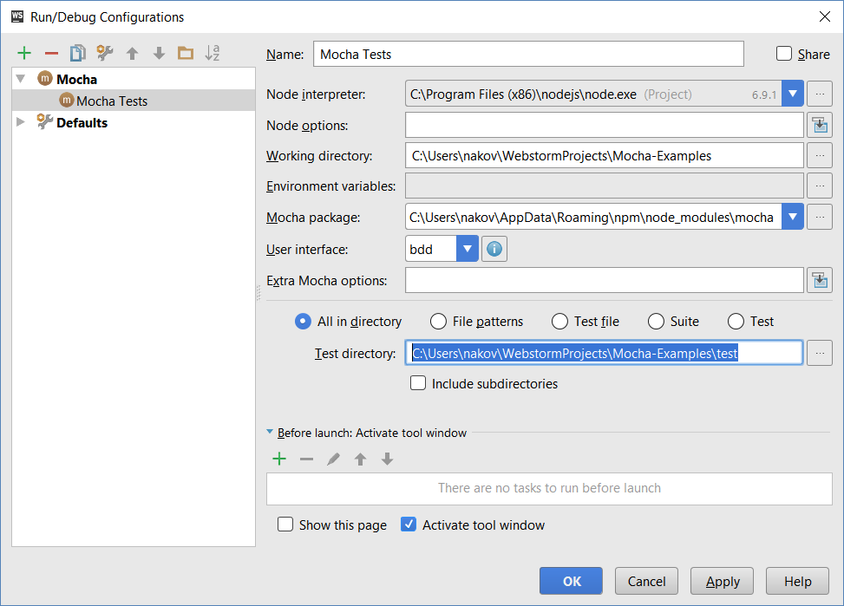
Configuring Mocha in WebStorm

Slide 26
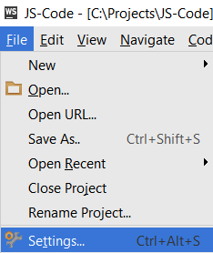
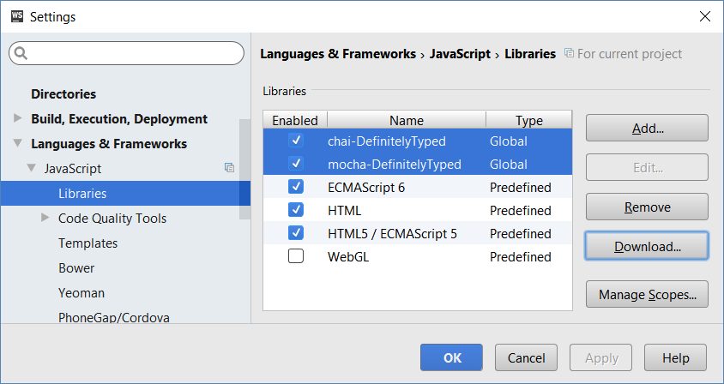
Configuring Libraries in WebStorm
To get the "auto complete" and "syntax checks" working for Mocha and Chai, add them as libraries in WebStorm.

Slide 27
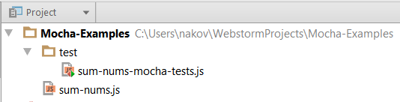
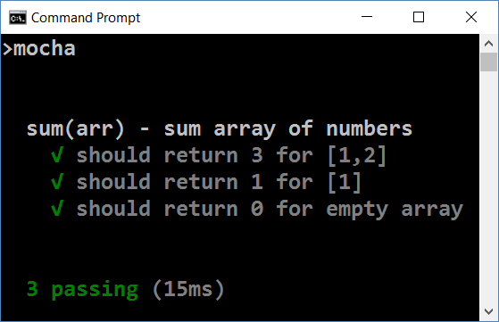
Running Mocha
Create folder "test" in your JS project.
Put your test code in test/{test-group-name}.js
Run mocha from the console

Slide 28
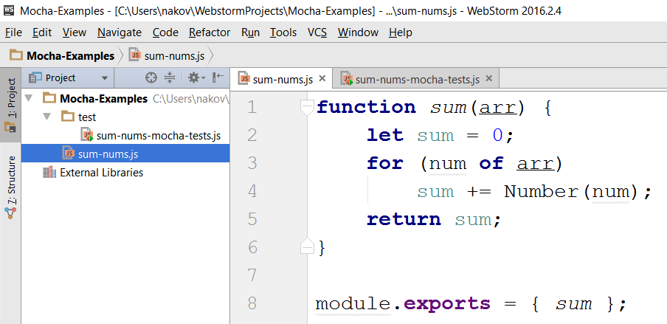
Sample Project
Source code to be tested

Slide 29
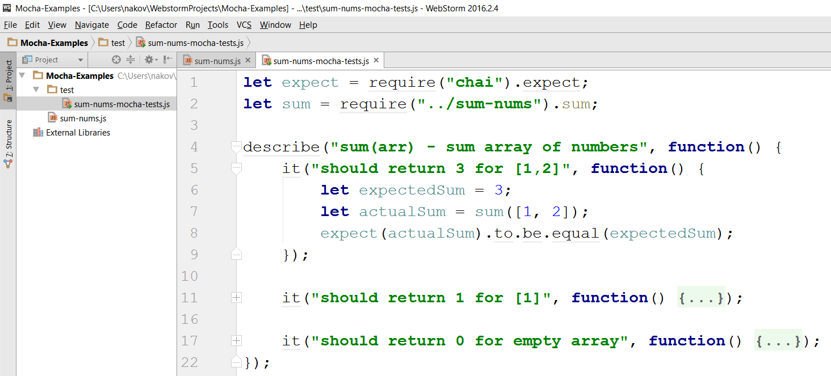
Sample Unit Tests
Tests for the sum(arr) function.

Slide 30
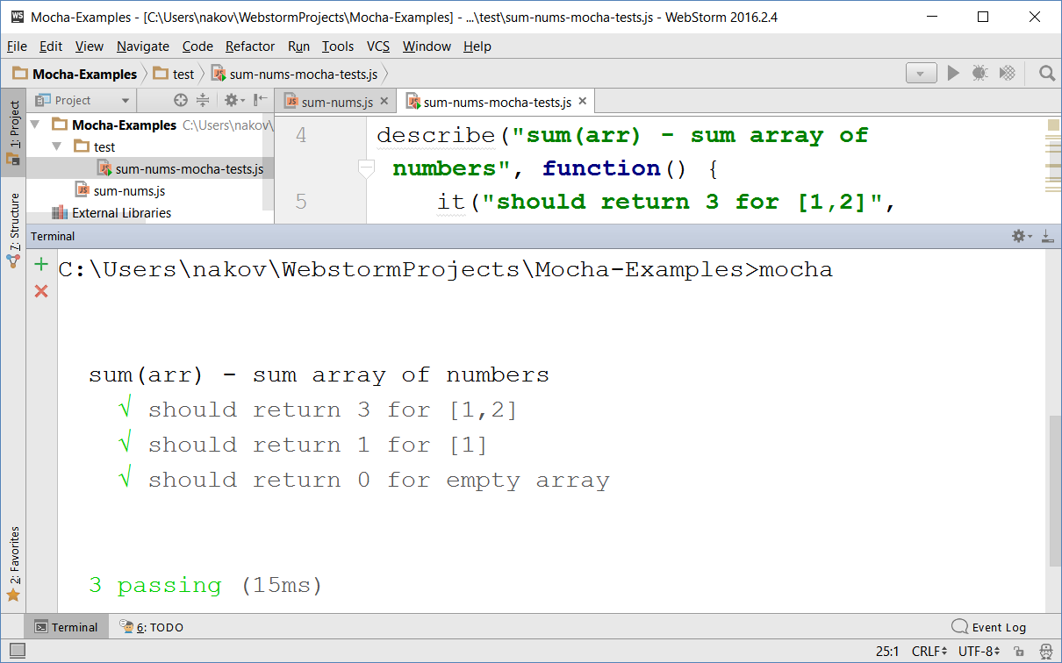
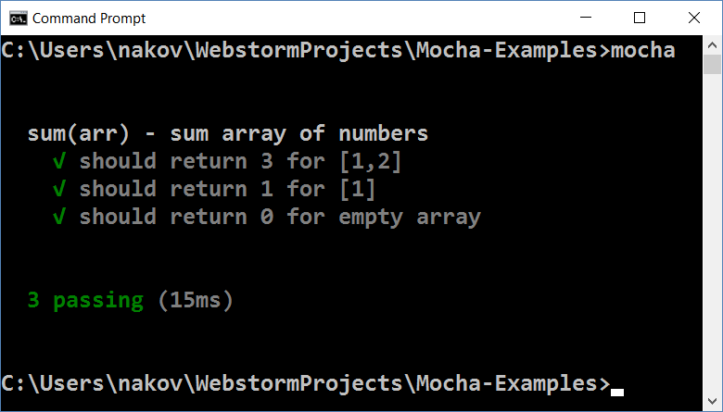
Running the Tests

Slide 31

VS Code Configuration

Slide 32

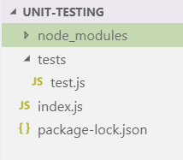
NPM Install
Install Mocha:
Install Chai:
npm install mocha
npm install chai

Slide 33
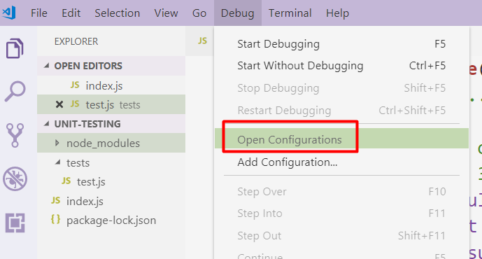
Configuration - launch.json
Open your launch.json file:

Slide 34
Configuration - launch.json
2. Add the following code:
{
"type": "node",
"request": "launch",
"name": "Mocha Unit Tests",
"program": "${workspaceFolder}node_modules\\.bin\\_mocha",
"runtimeArgs": [
"${workspaceFolder}/tests/test.js"
],
"console": "externalTerminal"
}
Path to your tests file

Slide 35
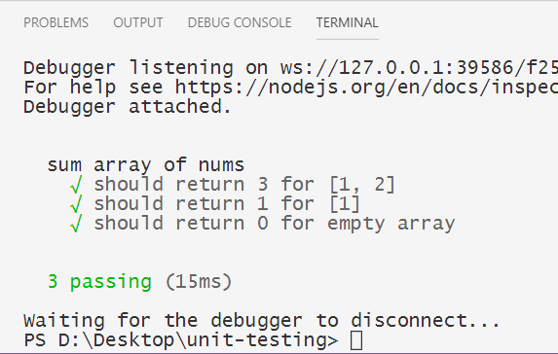
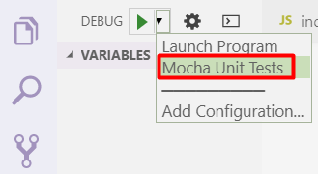
Configuration - launch.json
3. Choose debugging configuration:

Slide 36
Test Groups and Test Classes
let expect = require("chai").expect;
describe("Test group #1", function() {
it("should… when…", function() {
expect(actual).to.be.equal(expected);
});
it("should… when…", function() { … });
});
describe("Test group #2", function() {
it("should… when…", function() {
expect(actual).to.be.equal(expected);
});
…
});

Slide 37

Live Exercises
Unit-Testing

Slide 38

Summary
…
…
…
A function should do what its name suggests.
Exceptions are thrown when a function is unable tto do its work.
The throw statement lets you create custom errors.
Unit Tests check whether a piece of code works as expected.
Mocha is a JS test framework that is usually used together with Chai (assertion library).

Slide 39
https://softuni.bg/courses/javascript-advanced

Slide 40













SoftUni Diamond Partners

Slide 41




SoftUni Organizational Partners

Slide 42




Trainings @ Software University (SoftUni)
Software University – High-Quality Education and Employment Opportunities
softuni.bg
Software University Foundation
http://softuni.foundation/
Software University @ Facebook
facebook.com/SoftwareUniversity
Software University Forums
forum.softuni.bg

Slide 43

License
This course (slides, examples, demos, videos, homework, etc.) is licensed under the "Creative Commons Attribution-NonCommercial-ShareAlike 4.0 International" license

